Slide 1


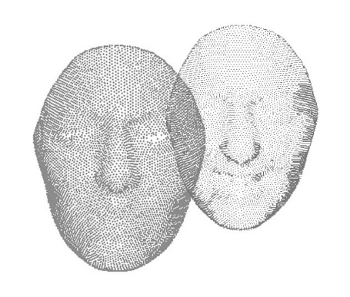
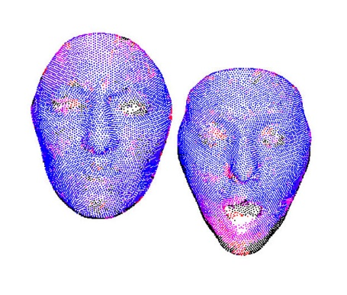
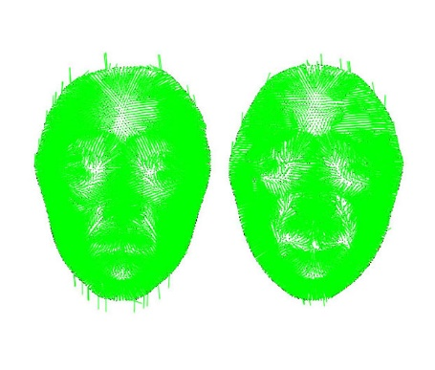
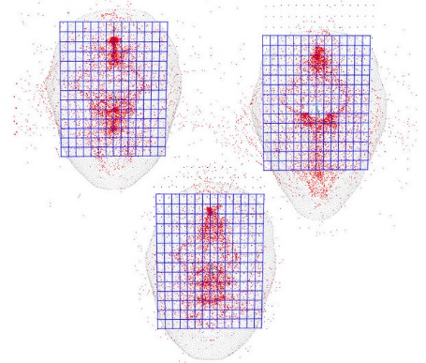
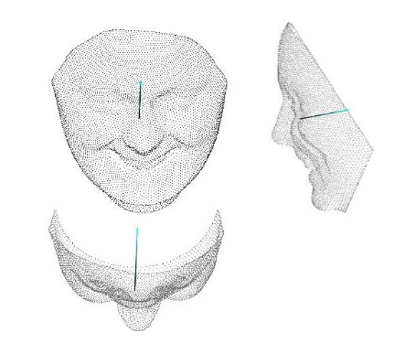
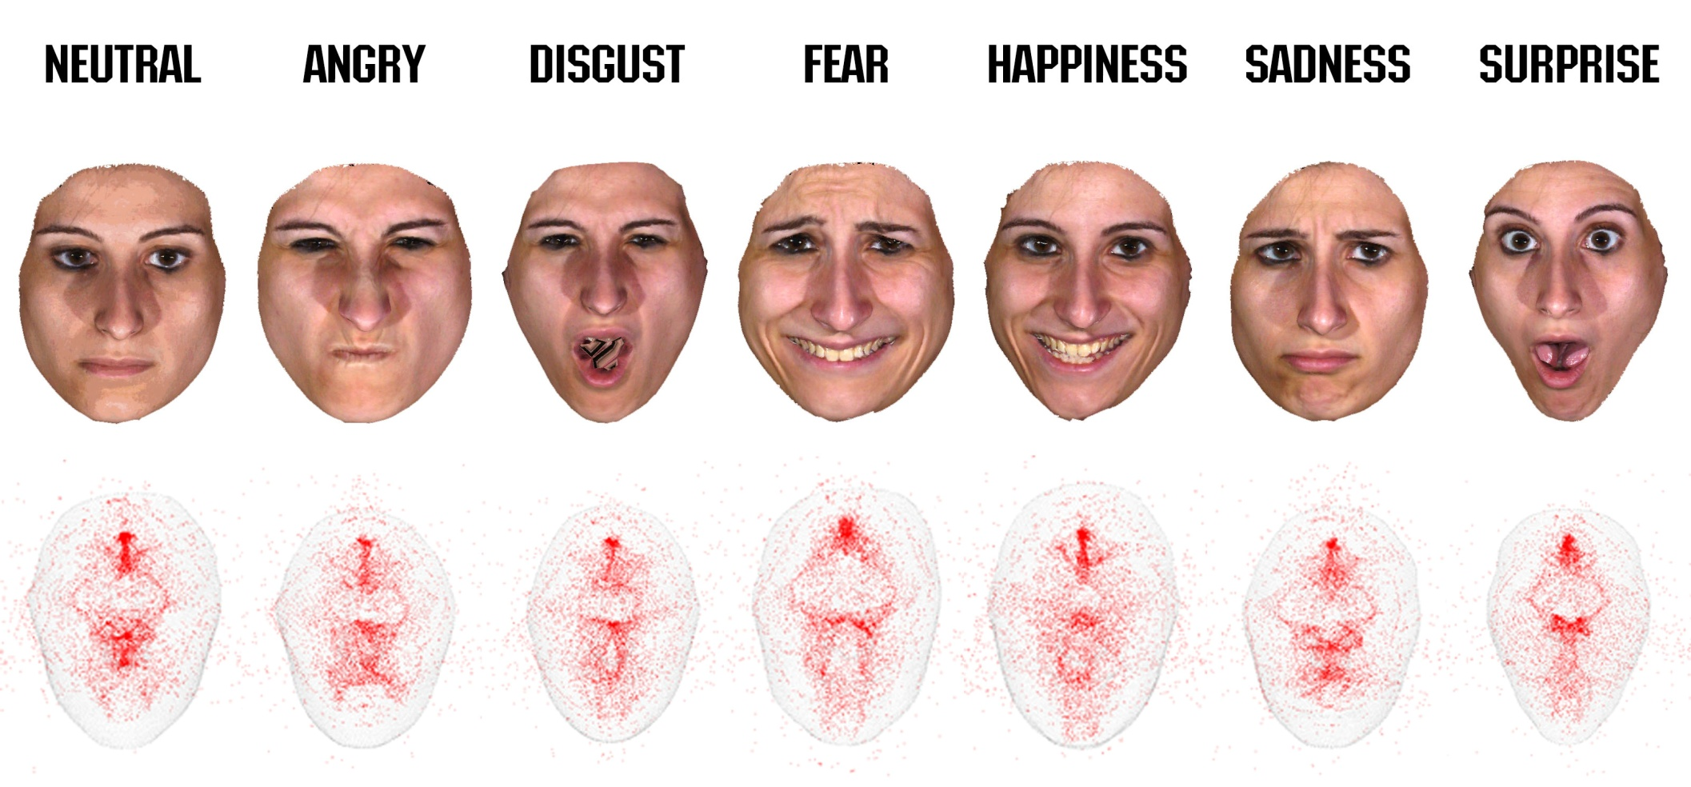
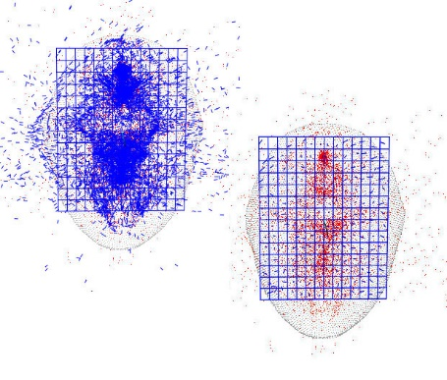
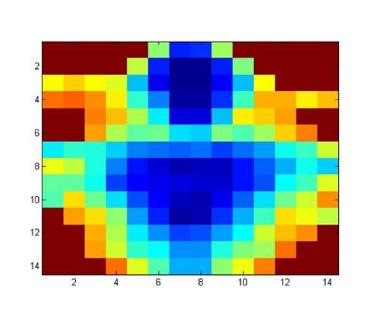

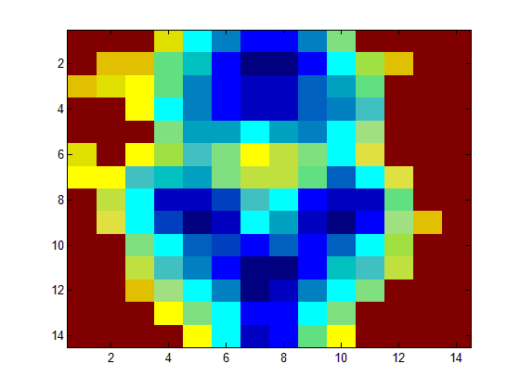
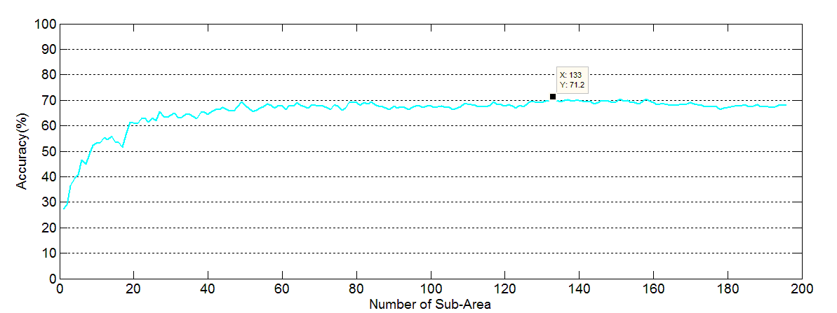
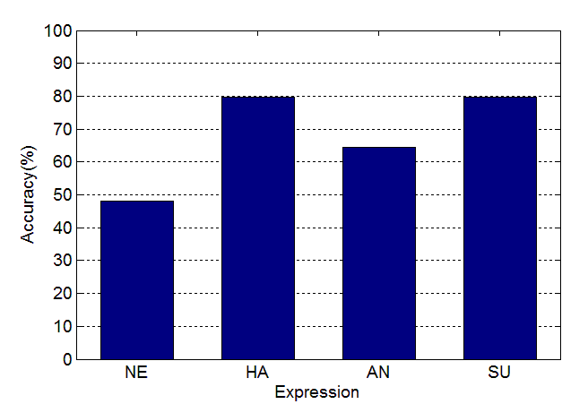
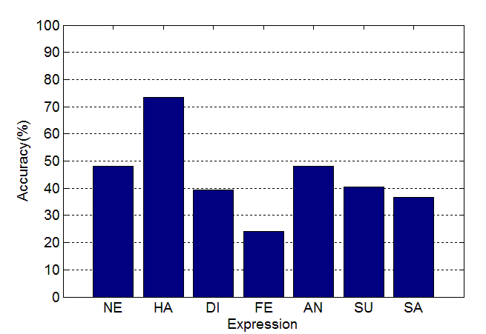
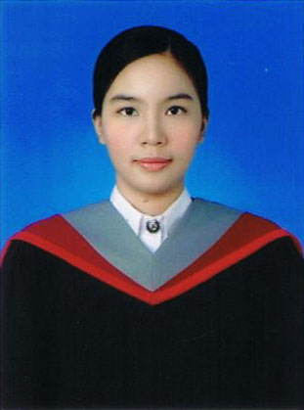
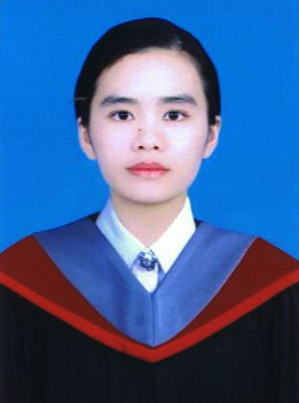
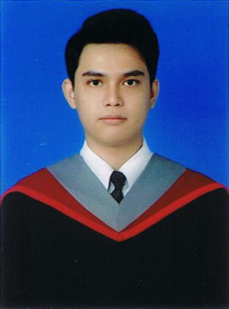
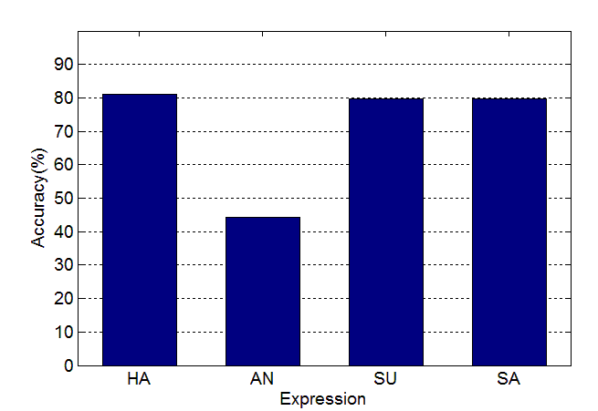
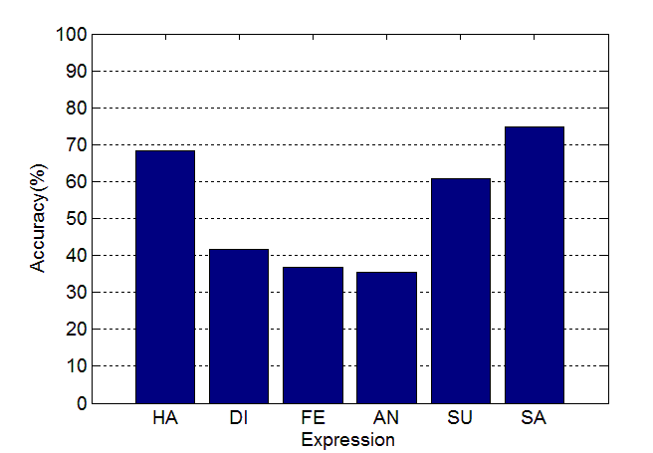
3D Facial Expression Recognition
by Partial Area on Face Plane
Biomedical Engineering, Faculty of Engineering, Srinakharinwirot University
Abstract
System Flow Chart
In this paper, a problem of previous research initiating when recognizine facial expression from 3D data set with all of the entries area that loss many time. We purpose a novel method for recognizing universal facial expression from 3D data set by select partial area on face plane. In order to recognize facial expression, we have created face plane which is derived by normalized vector. The face plane would be divided into 196 (14x14) region partitions by distinguish distribution of standard deviation of crossing point. Then create vector as a change on crossing point on face plane between neutral emotion and expression and apply sub area with principle component analysis (PCA) for find which sub area is significant to recognized thus 3D facial expression was recognized by supportive vector machine (SVM). The experiments were done for 4 expression (neutral, angry, happiness, surprise) and the recognition rate is 71.20 % according to using 133 from 196 region partitions. We also demonstrate the advantages of our recognition in the less rate of running program and reduce data of face plane. To escalate recognition, we prefer to recognize in real time and in different expression.
3D Image Acquisition
Face Superimpose Computation
Normal Line Computation
Crossing Point Computation
Derivation of the Face Plane
Crossing Point Distribution
Displacement Vector Set Computation
Facial Expression Recognition
Fig. 1. Show 7 expression such as neutral, angry, happiness, and surprise include Color data and Crossing point
Objective
Experimental Results
Coding and designing the program for recognize 3D facial expression.
Dividing face plane into unit area and pick the unit which is necessary to distinguish expression.
Comparing accuracy rate of recognition between Displacement vector set and Crossing point
The experiments were done for recognizing four facial expression (neutral, angry, happiness, surprise) from 100 persons in BU-3DFE. By using the displacement vector set method, the average correct recognition rates are 71.20% as shown in Fig. 4.3 and decrease face plane computation from 196 to 133 window area as shown in Fig 2. and Fig 3.
In next experiment, We use crossing point and displacement vector set to recognition by four and seven facial expression. The average correct recognition rates are 68.04%, 44.30%, 71.20%, 52.95% as shown in Fig 4. from top left to bottom right.
Conclusion
This research represent a method for recognize facial expression from 3D data set by select partial area on face plane that comprise of 1) 3D image acquisition and normal Line computation. 2) Face plane computation. 3) Crossing point computation for divide face plane into 196 (14x14) partial region 4) Displacement Vector Set computation 5) Principle Component Analysis and 6) Expression recognition by Support Vector Machine. The accuracy rate is 71.2% from all of 392 facial data set. The advantage of this research is decreasing data of face plane that help system assesses more quickly and rise the recognition rate.
Fig 2. The major sequence of subarea on face plane and invert selected area in order to recognize expression by deep red.
Fig 3. Comparison between numbers of subarea which calculate accuracy.
4 facial expression recognition by using crossing point
7 facial expression recognition by using crossing point
Advisor
Assistant Professor
Dr. Theekapun Charoenpong
4 facial expression recognition by using Displacement Vector Set
7 facial expression recognition by using Displacement Vector Set
Miss Sopa Potikanya
Miss Tanissorn
Lertpithaksoonthorn
Mr. Aslam
Meechai
Fig 4.

